Slide 1

Report on Exploratory Data Analysis (EDA) for E-retail factors for customer activation and retention study from Indian e-commerce customers
By: Atish Kalangutkar
Data Science Intern: Flip Robo Technologies

Slide 2
Problem Statement Customer satisfaction has emerged as one of the most important factors that guarantee the success of online store; it has been posited as a key stimulant of purchase, repurchase intentions and customer loyalty. A comprehensive review of the literature, theories and models have been carried out to propose the models for customer activation and customer retention. Five major factors that contributed to the success of an e-commerce store have been identified as: service quality, system quality, information quality, trust and net benefit. The research furthermore investigated the factors that influence the online customers repeat purchase intention. The combination of both utilitarian value and hedonistic values are needed to affect the repeat purchase intention (loyalty) positively. The data is collected from the Indian online shoppers. Results indicate the e-retail success factors, which are very much critical for customer satisfaction.

Slide 3
Understanding
So this a project based on customer activation and retention of online retailers that is E-retail.So this data set have been collected from a online shoppers.This project is categorical project.So what they have done is that they have given forms to 269 online shoppers and told them to give there feedback, so they were provided tick mark forms In which certain things are present such as if there should be ease of navigation in website or not, so they have to tick mark whether they agree or strongly agree something like that. So in this what people think about particular online retailers,such as they have included Amazon, Flipkart, Snapdeal, Myntra and Paytm. So this online shoppers have to choose what are there plus points, why they are choosing only specific online retailers and all other factors are mentioned in a tick mark form.So at last we need do decide which online retailer we will suggest to our friends.

Slide 4
Exploratory Data Analysis Steps
So in this project firstly I tried to understand the features in what way it is linked with the label. After that I imported the required libraries.
I used pandas and numpy to load the dataset, also to find shape of the dataset meaning to know the rows and columns present in the data set, than to find the data types of the each of every column, than to find if there are any null values present in the data set, than to check the names of the column,than to find the duplicates, than to find the unique values of a particular column and the count of that unique values in the column. Than used seaborn and matploblib to plot the several types of plots for visualization. So firstly loaded the data set, and by using data.head() code I checked the overview of the data set.
Than I checked for the shape of the data set, meaning how many rows and columns are there in data set, So there are 269 rows and 71 columns.
After that I checked if there are any null values present in the data set or not as I didn't find any null values present.
After that I tried to find the data types of the columns.So in that only one column has integer data type and rest of the columns has string data type meaning object.
Than I checked the each and every names of the columns .
After that I checked if there any duplicates or not, and I found that there are about 166 duplicates, so I deleted them all and again checked the shape, now my rows reduced from 269 to 103.
After that I checked for the unique values present In first column that is gender.So In that male and females were present. Than I checked how many males and females are present, so there are about 66 females and 37 males present in the dataset.
After that I tried to plot the count plot, so in that we were clearly able to see that females were more than males.
So i tried this steps for the columns which i felt like important for me to find out the best online retailer.
.

Slide 5
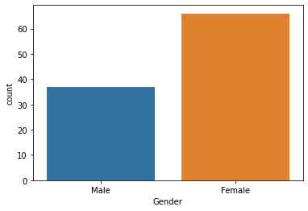
Visualiazation
By looking at the plot we can say that females are more than male. This means that most of the female shopes online compared to male.

Slide 6
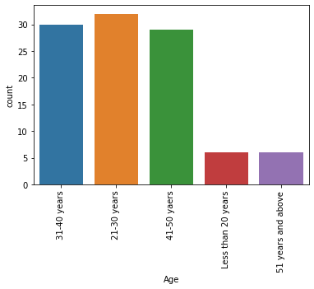
By looking at the plot we can see that the people with age between 21 to 30 years are more in numbers in this data followed by the people with age between 31-40 years and 41-50years. Least are from the age between 51 years and above and less than 20 years. That means most of the people that shops online are from the age group between 21-30 years followed by 31-40 years and least are from the age group between 51 years and above and less than 20 years.

Slide 7
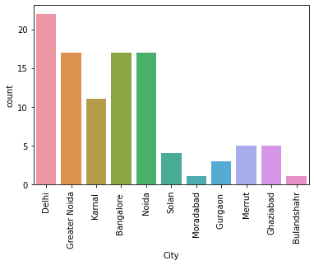
So by looking at the plot we can say that the most of the people are from delhi followed by Greater Noida,Bangalore and Noida. And least are from bulandshahr. So that means that most of the orders come from Delhi followed by Greater Noida, Bangalore and Noida.. Least of the orders come from bulandshahr.

Slide 8
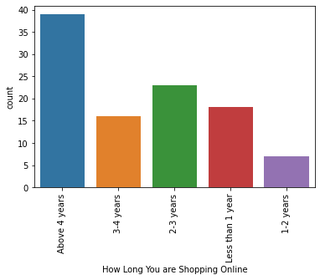
As we can see from the plot that most of the people are shopping online from past 4 years and above. And least of the people shopping online are from like 1-2 years.

Slide 9
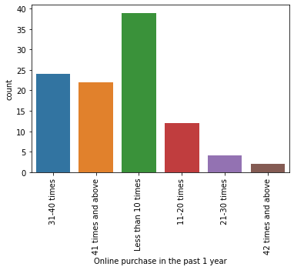
In we can see that most of the people have done online purchase i.e less than 10 times a year followed by people who have done online purchase 31-40 times a year and least is 42 times nad above, very few people have online purchase so many times in a year.

Slide 10
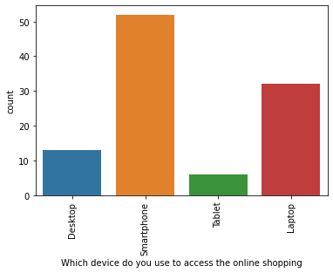
Most of the people use smartphone to purchase online and very less people use tablet.

Slide 11
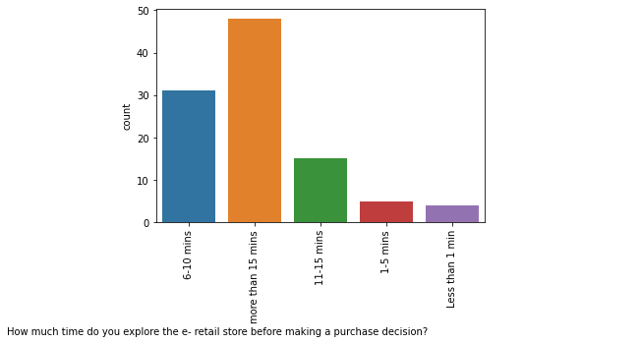
By looking at the plot we can say like most of the people spends more than 15 mins to explore the e-retail store before making any purchase

Slide 12
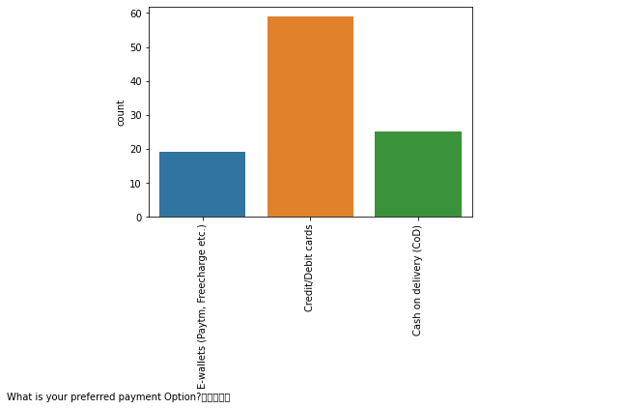
Most of the people prefer to pay by credit or debit cards

Slide 13
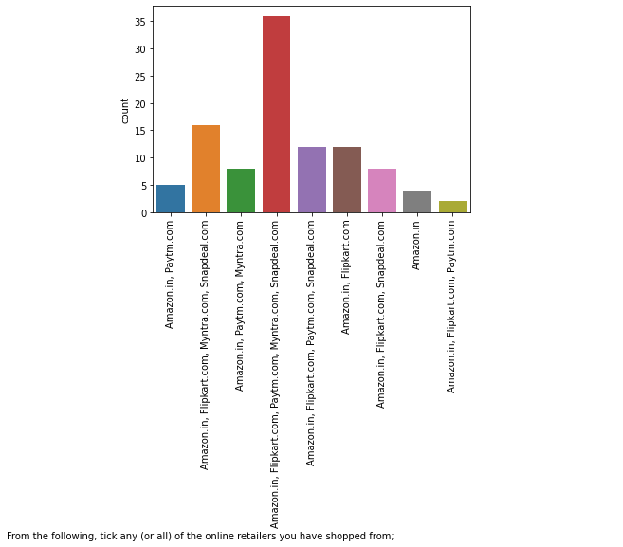
Most of the people have purchased online from every online retailer that is amazone,flipkart,paytm,myntra and snapdeal.

Slide 14
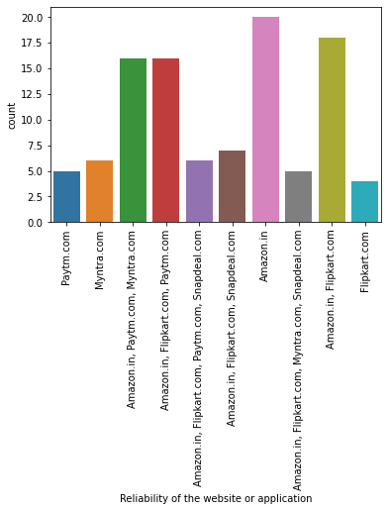
So we can see that most of the people think or say that Amazon website is the most reliable one.

Slide 15
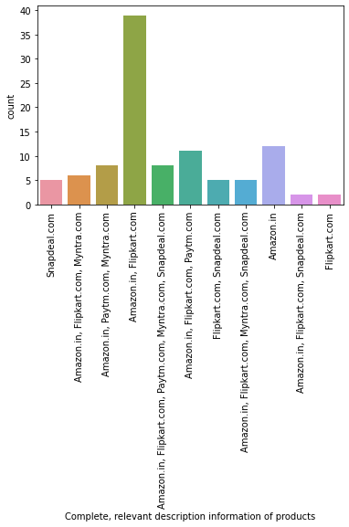
Most of the people says that Amazone and flipkart wensite provides with complete,relevant description and information of the products.

Slide 16
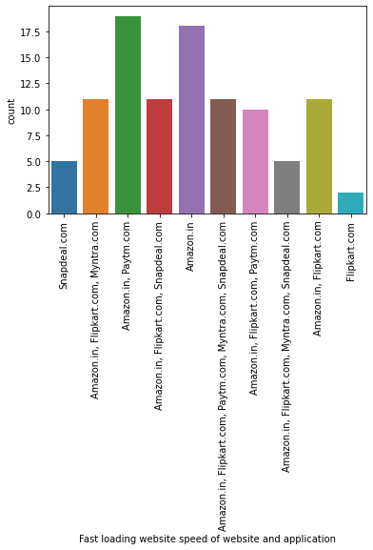
By looking at the plot we can say that amazone and paytm are the fast loading websites compared to several other websites

Slide 17
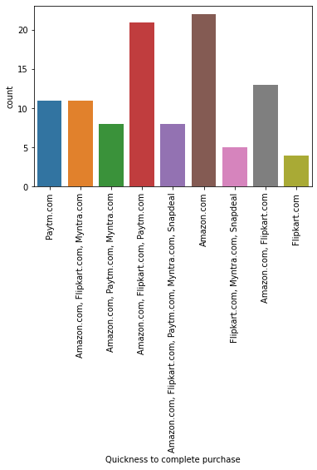
Most of the people have ticked marked or voted that Amazone is the quickest to complete purchase.As most of the people does not like to waste time. They want everything straightforward unlike some of the online retailsers they have so much of steps and formality that some people gets irritate and than drops of the idea of buying from that online retailer.

Slide 18
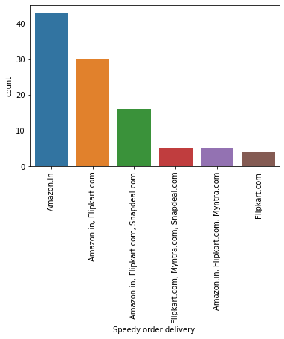
It seems that Amazone makes speedy order delivery which is very important for the people

Slide 19
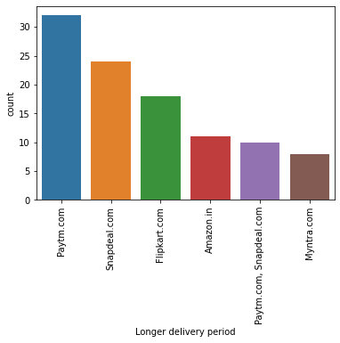
Most of the people think or says that paytm takes a long time to deliver the material which is purchased online.

Slide 20
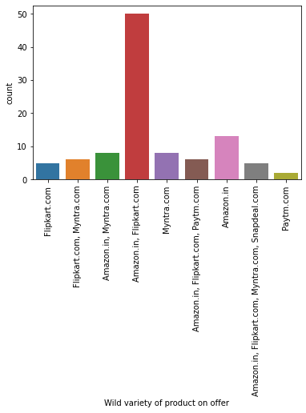
So it seems that amazon and filpkart website have more wide variety of products on offer compared to other online retailers

Slide 21
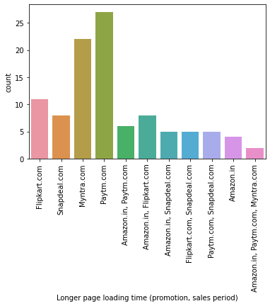
Most of the people agree that paytm takes more time to load the page.

Slide 22
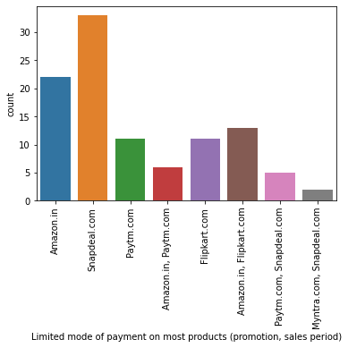
Most of the people agree that the snapdeal has the limited mode of payment on most products

Slide 23
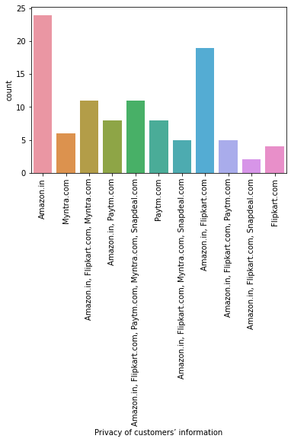
privacy also plays an important role as people does want others to know about there personal things.So most of the poeple think the amzone keeps the customer information very safe.

Slide 24
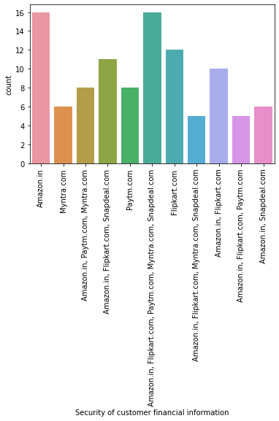
Again the customer financial information is a thing that should be leaked, its there should be a heavy a security for that, so most of the poeple think that Amazon keeps the finacial information of the customers very safe.

Slide 25
Analysis
Most of the people strongly agree that return and replacement policy of the e-retailer is important for purchase decision, not that all the people but seriously I also feel that it important because while shopping online we don’t know a particular item will fit us in terms of size or with our looks may be it is shoes or clothes or anything, so return and replacement policy plays important role for purchase decision.
Most of the people feel that Amazon website is the most reliable one followed by Flipkart.
So further analysis shows that according to most of the online shoppers Amazon and Flipkart gives complete,relevant description and information about the projects so that people should know what is the product/item. From what it is made up of and all. Some people want specific material products so it important to give complete and relevant description and information about the product.
According to most of the online shoppers its seems that Amazon and Paytm website are the fast loading websites. It is important because because if it is taking a long time to load the website than some of the online shoppers gets irritate and than directly comes out of the website, some of them doesn't have passions to wait every time to load the website. So it is important for online retailers to check the loading speed of the website because of this they may lose their valuable customers.
Quickness to complete purchase also plays an important role because if you are selecting a certain product/item for purchase than the further steps to purchase should be very smooth and easy to understand. There should not be any unwanted popups or u-turn while doing purchase.So by analyzing it seems that Amazon is the quickest to complete the purchase.
Now the speedy order delivery plays an important role because some of the people really need the item or product as fast as possible may be because it not available in the shops nearby. So at that time speedy delivery play an important role.So by analyzing it came into my notice that most of this online shoppers think that Amazon does the fastest delivery compared to other e-retailers which is a very important positive thing for the people to choose Amazon over other online retailers.

Slide 26
Analysis
Now about the longer delivery period, I don’t have to explain about this because its makes a vast impact on the purchasing because no person likes to wait for a longer period once the item/product is ordered. So by going through the dataset and analyzing it seems that Paytm takes a long time to deliver the material.
When this online shoppers were asked about the loading and processing speed is important or not, so most of them strongly believe that loading and processing speed should be good.
About the payment methods most of them strongly agree that the there should be convenient payment methods.
Also most of them think that there should be wide variety of listed product in several categories because it becomes easy for a person to choose and also to compare.
And here comes the discount or offer, So by analyzing is seems that Amazon and Flipkart has a wide variety of products on offer, so obviously people will get attracted to that website because offers on products plays an major role to attract the people.
So in above one point I had mentioned about what this online shoppers think about the loading and processing speed , so most them strongly agreed for it that there should be any problem loading page or it should take a lot of time to load the page. So by analyzing I came to know that Paytm takes the longer time to load the page.
Snapdeal has the limited mode of payments and I think if there is a good discount on any of the product, and a person wants to purchase that item/product and if there is suitable mode of payment than that person obviously will go to other website and if he finds the same offer over there with the suitable mode of payment than surely he will purchase from that website.
Now coming to the monetary benefits and discounts, as it also attracts people, as it give them extra benefits while purchasing, so it seems that most of the people strongly agree that online shopping gives them monetary benefits and discounts.

Slide 27
Analysis
Trust, this word is very important in any business. So most of them strongly agree that they have trust on the online retailers that they will fulfill its part of transaction at the stipulated time, this thing comes into notice when the person ask for refund and when your money is refunded within a time period. So in this what happens people starts trusting that online retailer and which also gives a user a satisfaction that whatever that was being promised is been accomplished.
Now about the privacy of customer information and security of the customers financial information, it is very important that this thing should be leaked outside as the financial information are very confidential. So after doing analysis it comes into my notice that Amazon keeps its customer private information and as well its financial information very safely and under high security so that it should get leaked.By this people get confident that nothing wrong will happen if we purchase through this online retailer.

Slide 28
Conclusion
By going through each and every aspect , analyzing each and every thing and keeping above points in mind I would recommend Amazon as the best online retailer because of particular reasons, they are:
Firstly they provide better privacy and security for the the customers personal as well as financial information.
It provides with wide variety of products with offer and also it gives wide variety of items/products to choose and compare.
It delivers the product/items as as fast as possible compared to others(speedy order delivery).
Quickness to complete purchase.
Loading and processing speed of the website is faster than others.
It gives complete, relevant description and information about the products.
Website is very easy to use.
And about the other 4 websites that is Flipkart, Myntra,Paytm and Snapdeal.
I can say that Flipkart and myntra are also good but they lack some x factors such as speedy delivery.
And about Paytm and Snapdeal as they takes a longer delivery time as well as it has less mode of payments so I wont recommend it.

Slide 29
THANKS

